Slide 1
What the F#*%?
By @ChrisTruncer & @JoeLeonJr
(@FortyNorthSec)

Slide 2
We’re FortyNorth Security
@ChrisTruncer
Some Offsec guy at FortyNorth
Creator Veil Framework, WMImplant, EyeWitness
Presented/Trained at: Blackhat Asia, BlackHat USA, WWHF, DerbyCon, Shmoocon, Troopers
Former Sys Admin
@JoeLeonJr
Offensive Security Engineer
Creator EXCELntDonut, C2Concealer, Hot Manchego
Presented/Trained at: BlackHat Asia, BlackHat USA, WWHF
Former Software Engineer
Former Sales Consultant
Notes:
JOE DOES THE NEXT 6 SLIDES

Slide 3
Story Time
Notes:
Notes:
In December last year (2020), a client asked us to do an internal pen test. We were provided a VM on their network and tasked with a few objectives.
One of those objectives was seemingly simple – establish C2 communications. Easy, right? It took us three days.

Slide 4


Goal
BUT…
Establish command and control (C2) communications on VM
Notes:
This organization was locked down. They had Windows ATP deployed, they were running Carbon Black’s Bit9 application whitelisting solution to block unsigned EXEs and DLLs, and due to previous engagements with us, had blocked all of the common AWL bypasses we typically use.

Slide 5
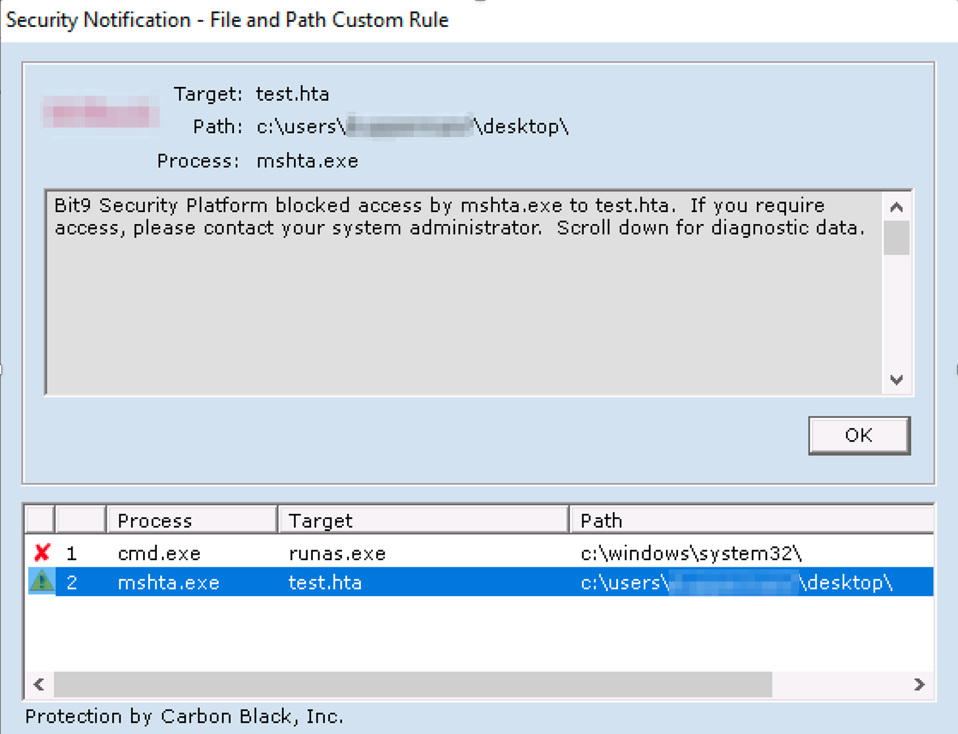
Notes:
Notes:
All of our application whitelisting bypasses failed to work. Even some of the latest tactics we teach in our red team course were getting blocked.

Slide 6
Tried and failed…
Msbuild (multiple variations)
InstallUtil
DotNetToJScript/GadgetToJScript
WMIC
RegSvr32
GhostLoader
Various EDR Bypasses
...many more…
Notes:
We tried all types of inventive ideas to bypass their defenses, but repeatedly failed.
Either was blocked outright OR we’d get an initial beacon and it would be killed instantly. UNTIL.

Slide 7
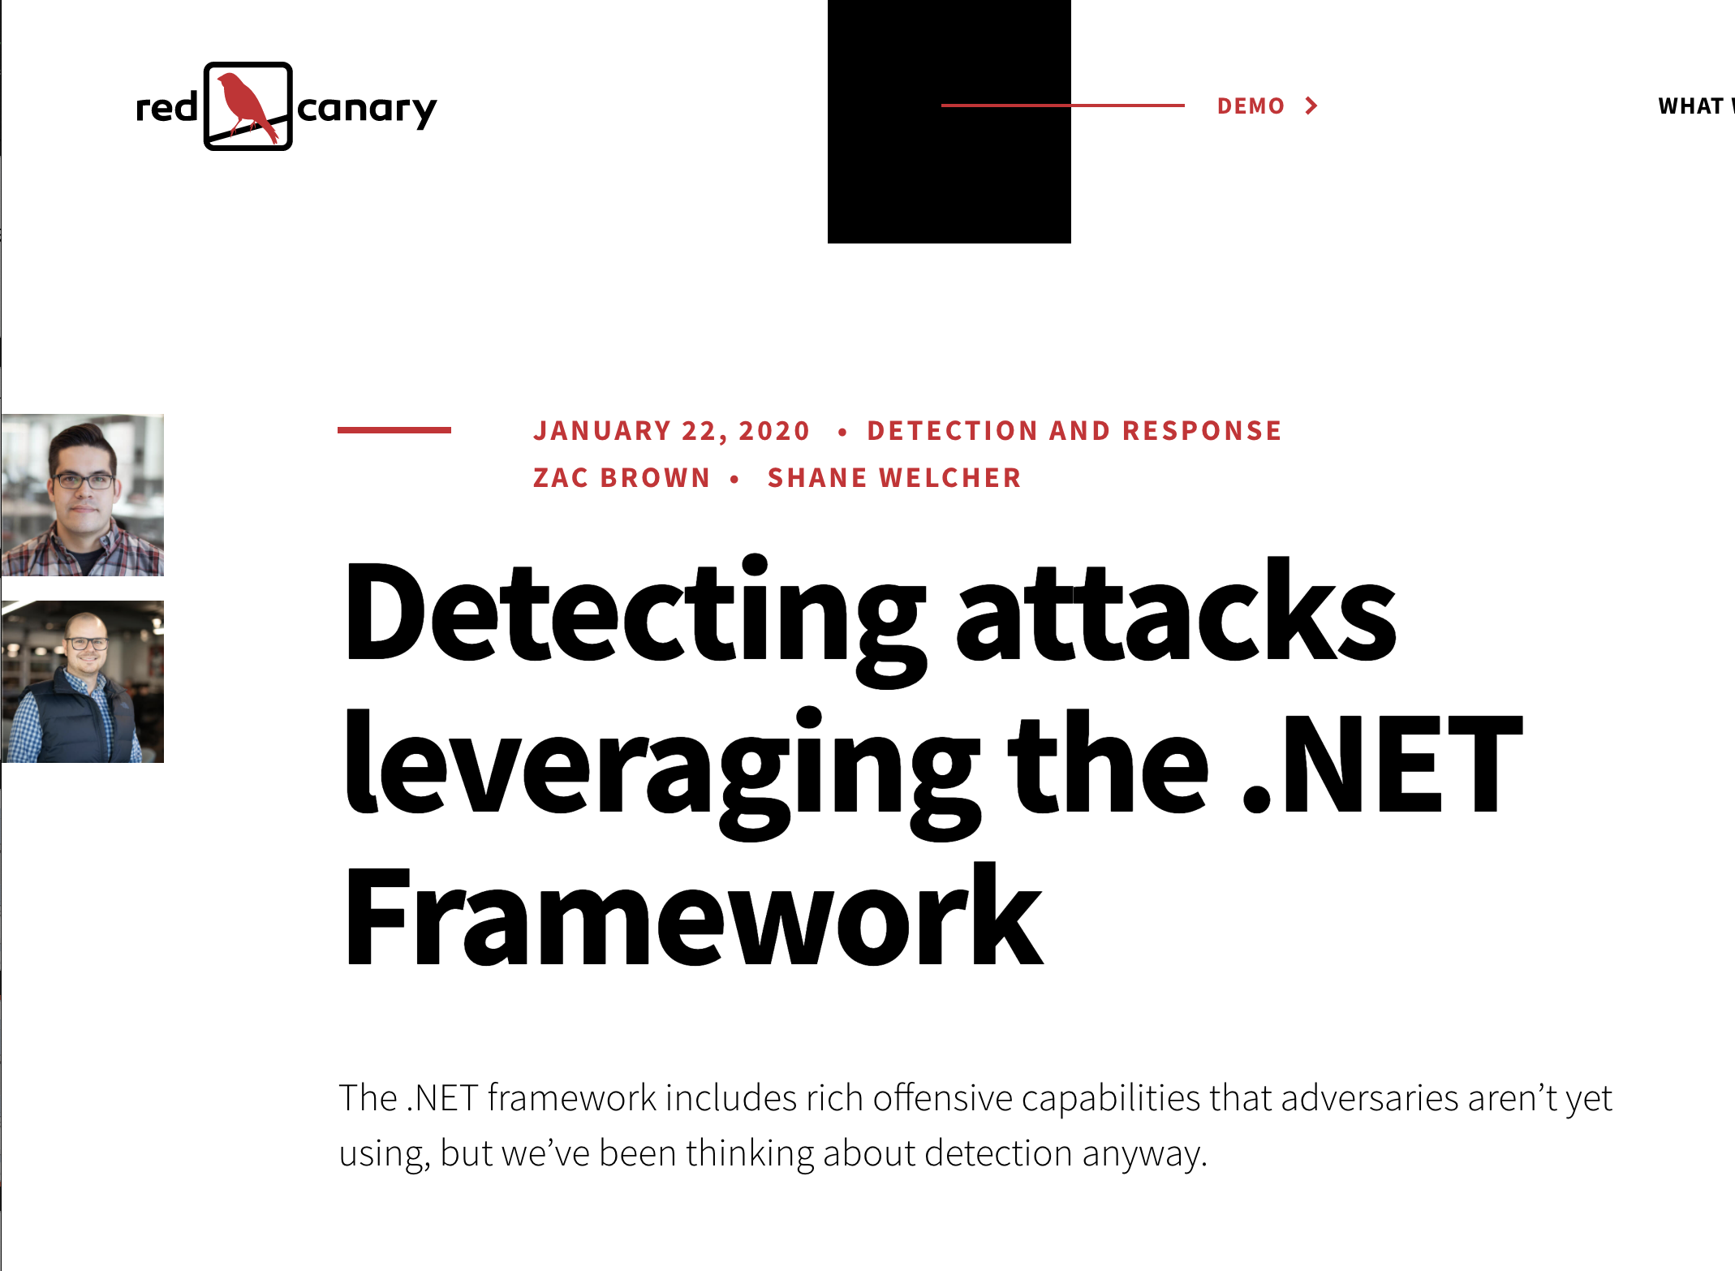
Notes:
Notes:
We remembered this article that Red Canary put out in January 2020 by Shane Welcher and Zac Brown.
The authors describe how adversaries could use C# or F#’s interactive scripting console to execute scripts. It’s part of the “Bring your own land” technique.

Slide 8
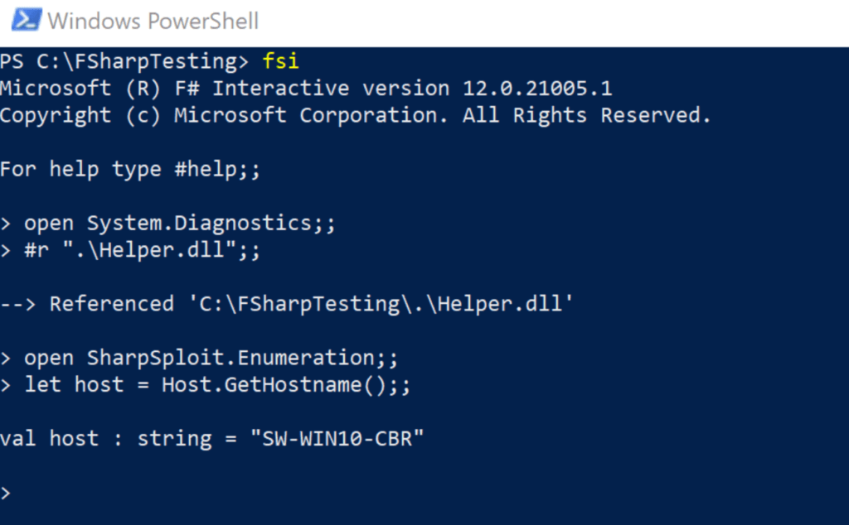
Notes:
CHRIS DOES THE NEXT 7 SLIDES
In particular, we saw this image and thought we might be able to use F# on our assessment. In this image, the folks are Red Canary loaded up Sharpsploit’s DLL and enumerated the hostname.

Slide 9
What is F#?
Notes:
Intro to the language, relation to C#, intro to idea of scripts and assemblies.

Slide 10
What is F#
It’s a function oriented language
It’s designed to automatically infer data types
Let’s you focus on your code versus the nuances of programming
You can use pure .NET code mixed with F#
Console.WriteLine()
It’s also a pain in the ass
The syntax isn’t intuitively picked up coming from a Python, PowerShell, or C# background
Compiling binaries can be confusing if wanting a single executable in Visual Studio
Notes:
We tried all types of inventive ideas to bypass their defenses, but repeatedly failed.
Either was blocked outright OR we’d get an initial beacon and it would be killed instantly. UNTIL.

Slide 11
Compiling F#
How do you compile code in F#?
Well, there’s multiple ways
Mono in Linux
Visual Studio
Fsc.exe
… and others
Let’s look into these options
How they work
Any benefits

Slide 12
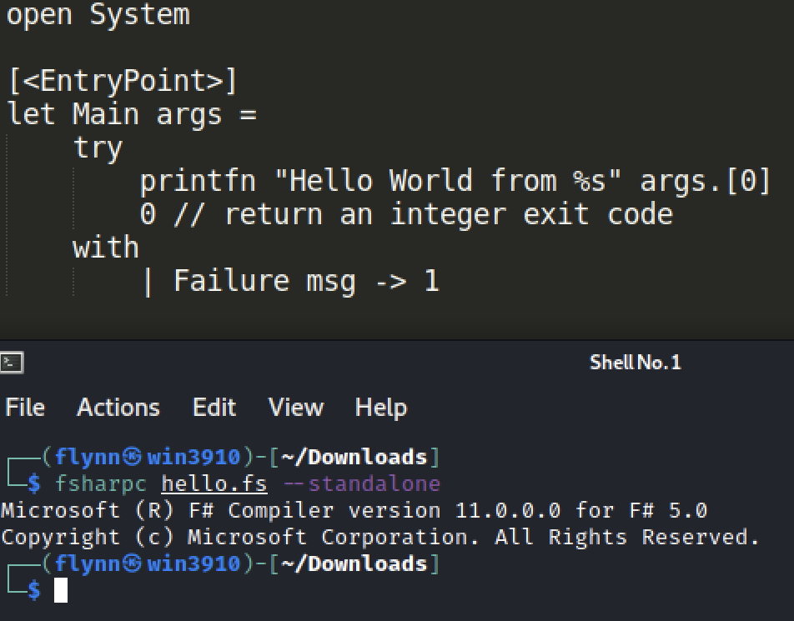
Compiling F# with Mono

Slide 13
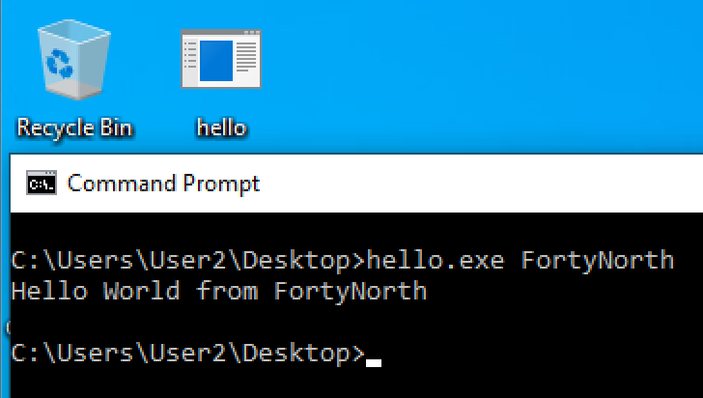
Compiling F# with Mono
Notes:
The code works and we get our hello world
Benefits of this are we aren’t restricted to a windows environment to compile standalone f# applications
We can just take the compiled app and run it on a windows system

Slide 14
Compiling F# with fsc.exe
Fsc.exe is a F# compiler for Windows
It is not installed by default on Windows systems
The easiest way to get it installed? Install Visual Studio 2019
Finding its location can be another story
https://fsharp.org/use/windows/
Notes:
JOE DOES THE NEXT 9 SLIDES

Slide 15
Weaponization of F#
Shellz in F# (Story Time)
Notes:
Picking back up on our engagement in December. We had failed to establish a C2 channel using nearly every trick in our toolkit, until we tried using F#.

Slide 16
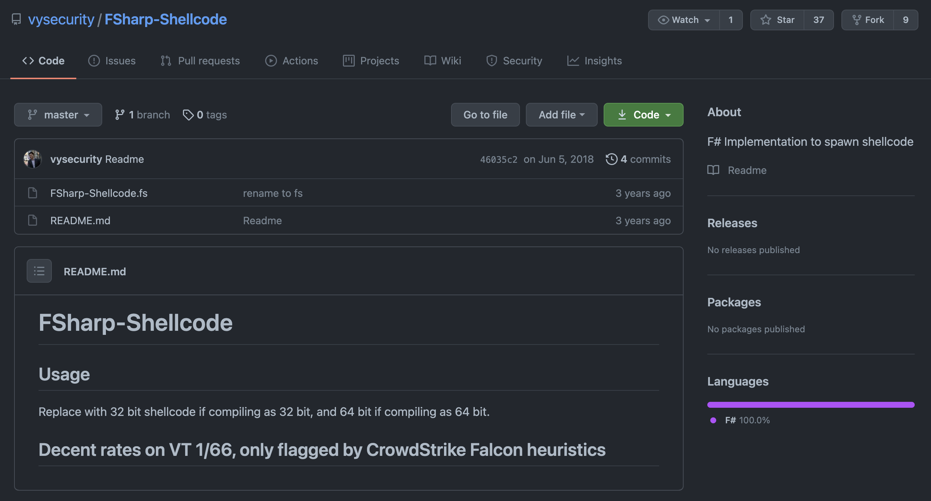
Notes:
Since our goal was establishing comms, the first thing we did was search for a shellcode injection template in F#. Fortunately, Vincent Yiu had already built one a couple years back. Armed with a proof of concept F# source code file, we went to work to figure out how to execute F# on the target machine.

Slide 17
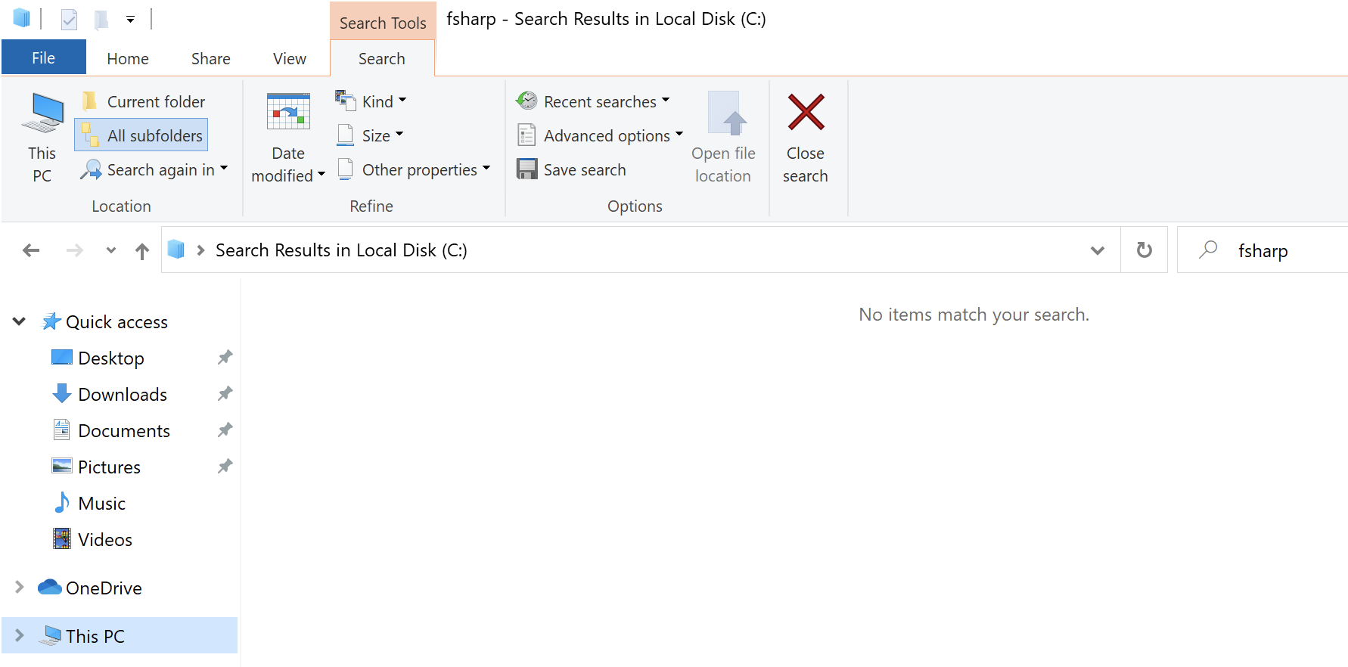
Notes:
If Visual Studio isn’t installed, F# won’t execute.

Slide 18
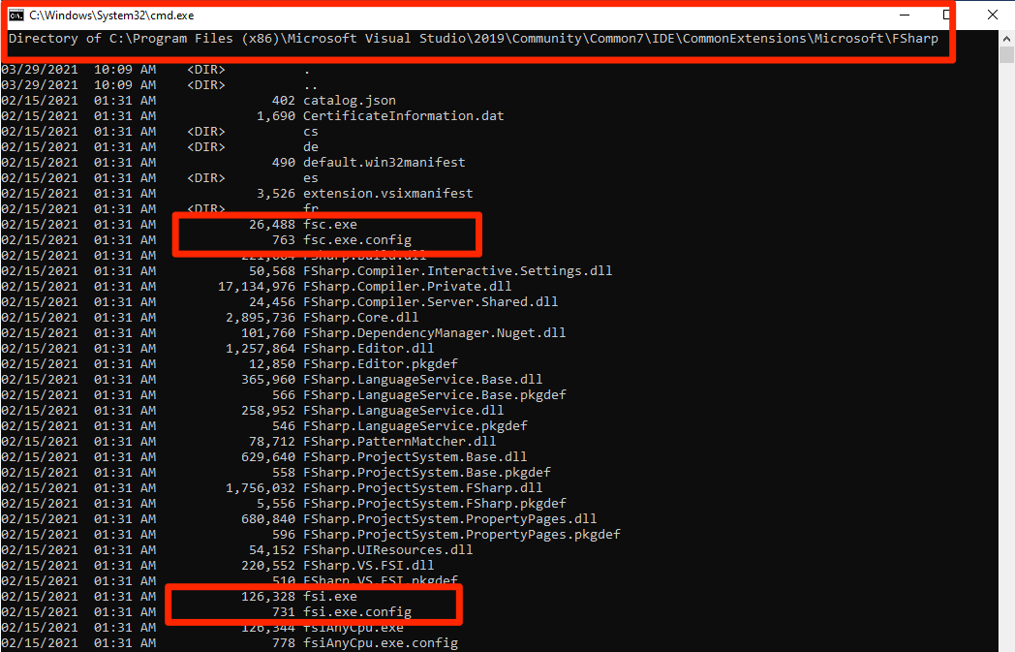
Notes:
But on our VM with Visual Studio installed, we found fsi.exe.

Slide 19
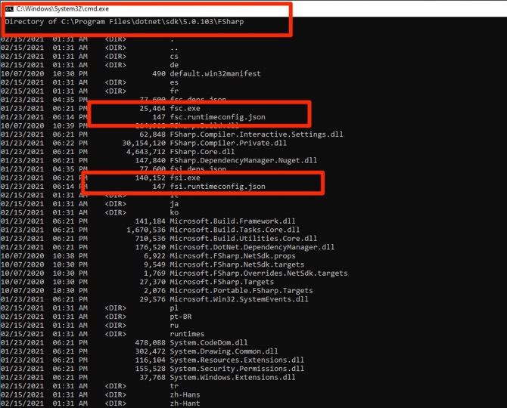
Notes:
As an alternative location, check out the dotnet subfolder in Program Files for an x64 version of fsi.exe.

Slide 20
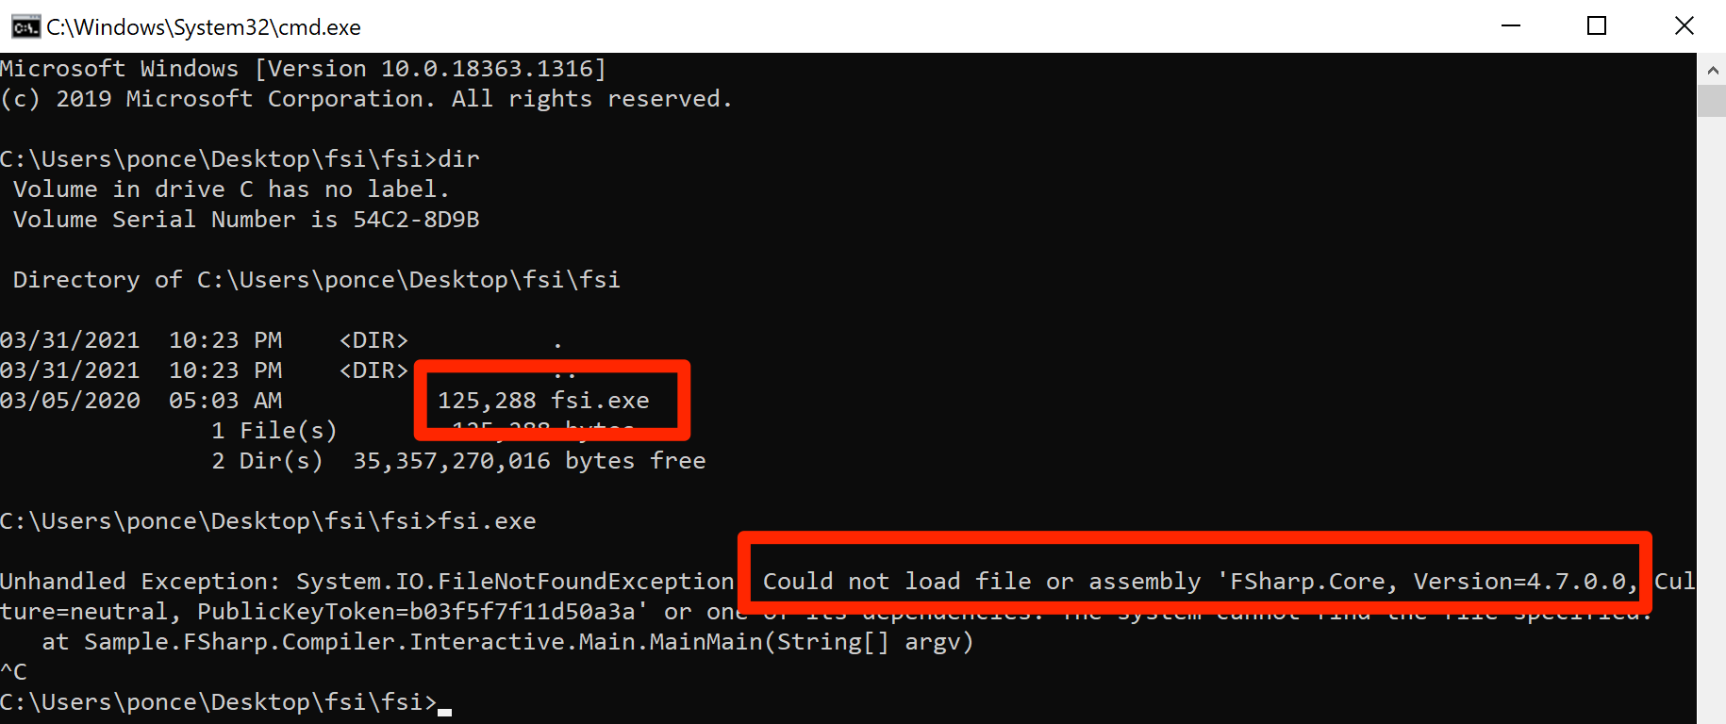
Notes:
We used FSI, but had to iteratively figure out what files were needed.

Slide 21
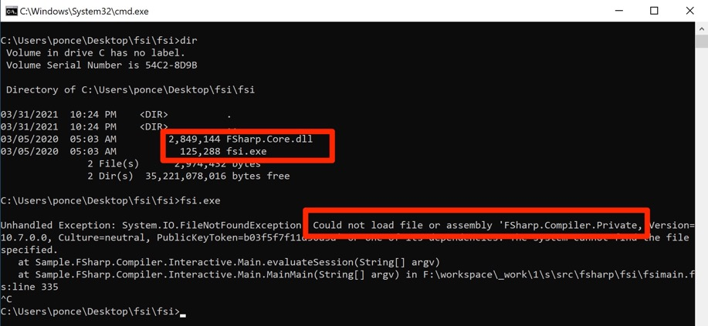
Notes:
We used FSI, but had to iteratively figure out what files were needed.

Slide 22
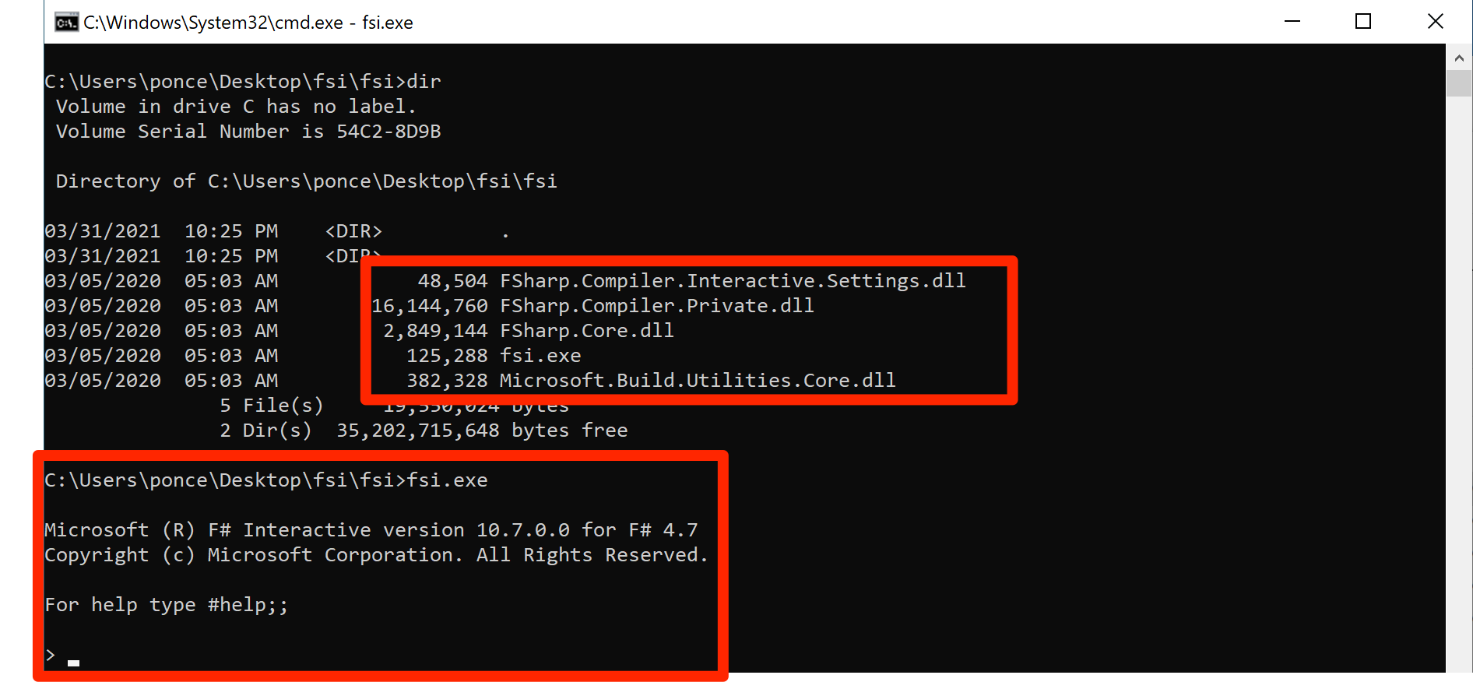
Notes:
Transferred the files over. And eventually found the 4 additional DLLs required to execute FSI.exe on a remote machine.
So we zipped those five files and copied them over to our target machine. Since they are all Microsoft signed files, we could execute them.

Slide 23
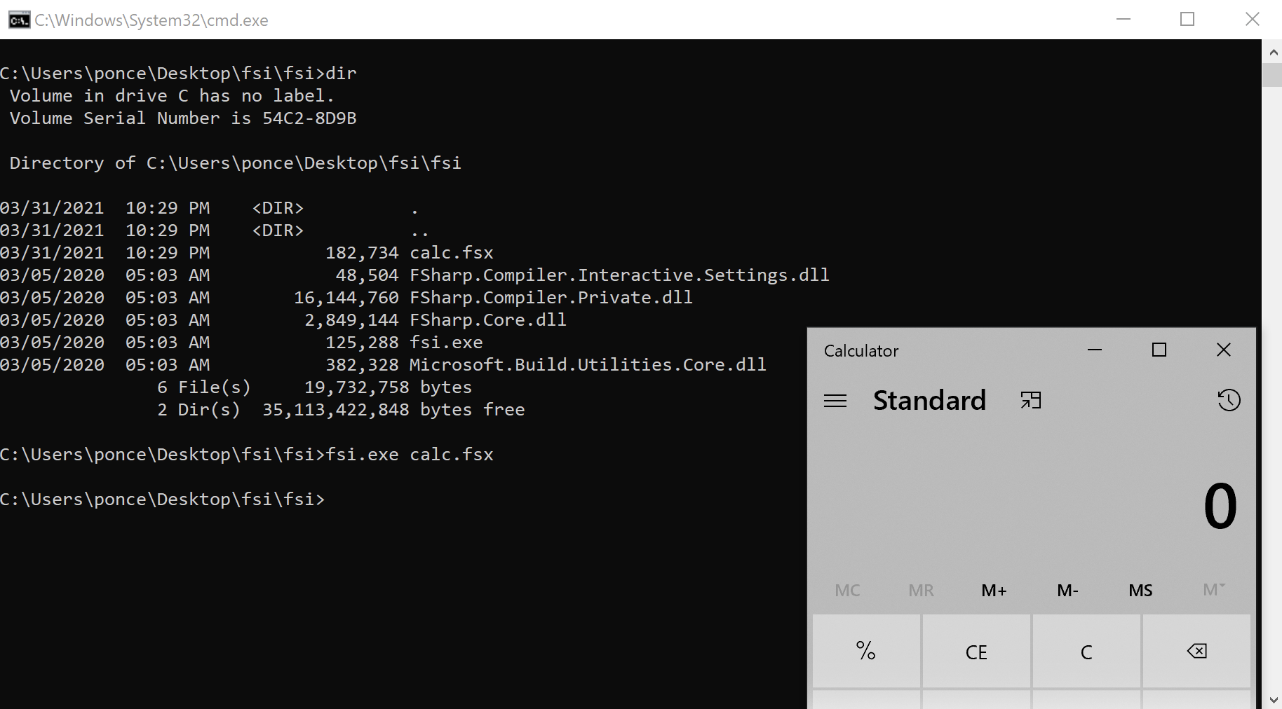
Notes:
CHRIS DOES THE NEXT 11 SLIDES
As a proof of concept, here’s a F# script file with shellcode for popping calc and executing through fsi.exe.
Since then, we’ve dedicated some time to learn how to code in F# and add to our internal toolset additional F# tools.
Reiterate how this allowed us to drop only Microsoft-signed files and then our scripting file…and got execution.

Slide 24
Execute-Assembly + F#
Notes:
One of the most used techniques in offensive security is a concept called Execute-Assembly. For those not familiar with it, it’s built into popular C2 frameworks like Cobalt Strike, Covenant, Meterpreter, etc. The idea is you write whatever code you want to execute on your victim machine in C#, compile it and then pass the local assembly into the C2 framework and it’ll execute that assembly in memory on the target machine.
Let’s take a closer look at how this typically works with C#.

Slide 25
Notes:
Here is your typical Hello World program in C#.

Slide 26
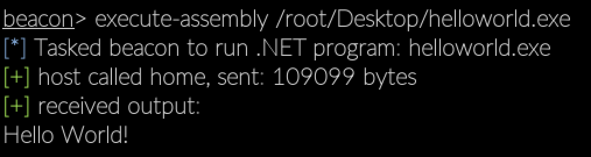
Notes:
As expected, the assembly executed in memory and spat out our line of text.
Before we try this in F#, let’s take a quick peek under the hood to see how the execute-assembly concept works.

Slide 27
Execute-Assembly Under the Hood
You’re having unmanaged (C/C++) code load the Common Language Runtime (CLR) within itself to execute .NET code
After the CLR is loaded into the current process, you have the ability to execute managed code (.NET code)
This ability is useful because you can inject your .NET assembly into another process without having to drop your .NET code to disk
Avoid any AV detection
Avoid any endpoint protection copying your binary off for future analysis

Slide 28
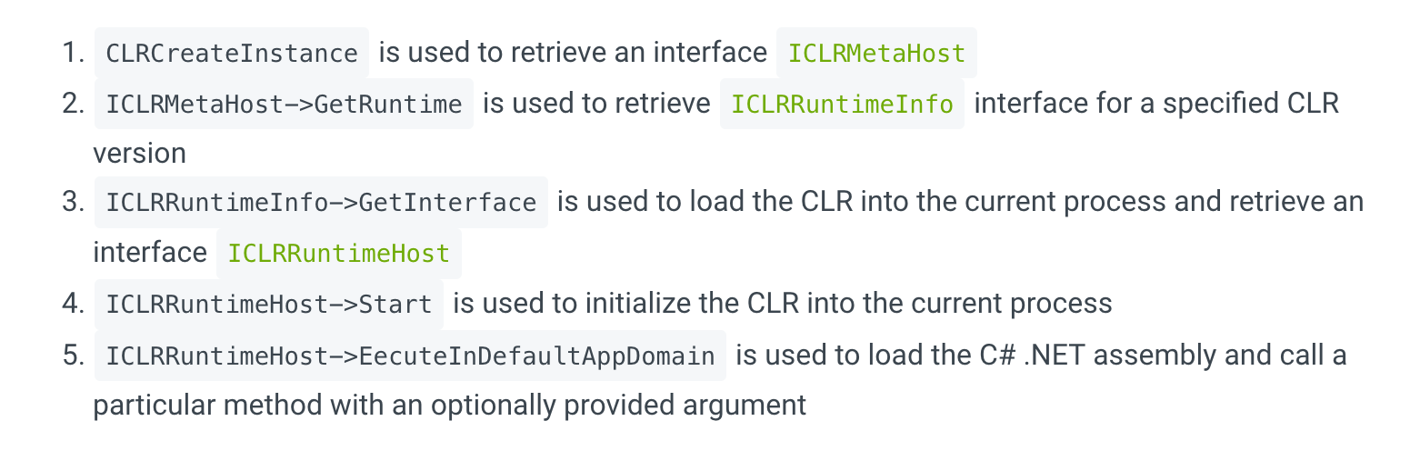
https://www.ired.team/offensive-security/code-injection-process-injection/injecting-and-executing-.net-assemblies-to-unmanaged-process
Notes:
Slides detailing CLRHosting…explaining the different components. This is needed to set us up for:
Understanding what Invoke_3 failed error means in CS (which is when we try to execute F# via execute-assembly)
Updating execute-assembly to work for F#.

Slide 29
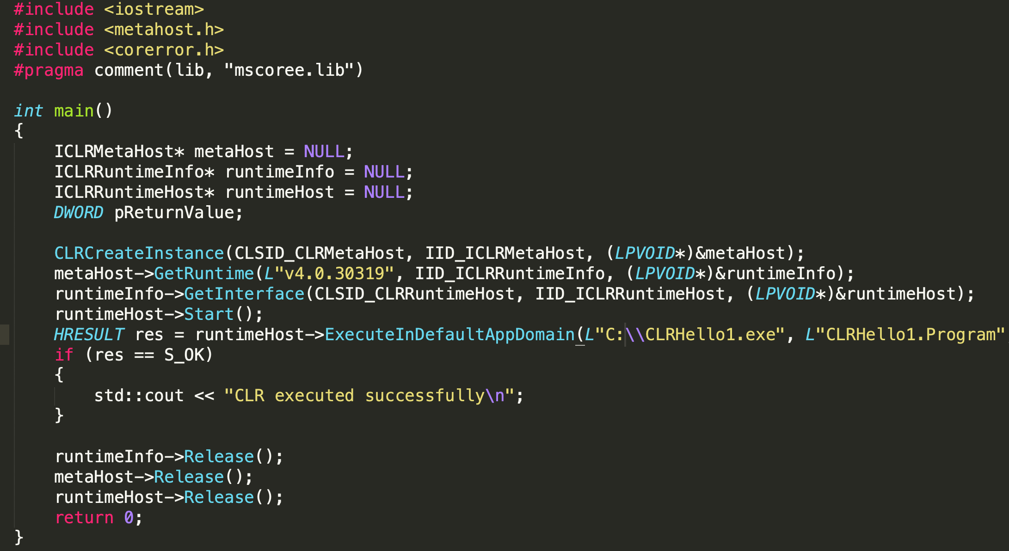
https://www.ired.team/offensive-security/code-injection-process-injection/injecting-and-executing-.net-assemblies-to-unmanaged-process

Slide 30
Coding for Execute-Assembly
There’s really one primary coding requirement that you are going to need to follow
You’re going to essentially want one global try/except for your .NET code
Invoke_3 Error anyone?
That’s not just a Cobalt Strike annoyance, it’s required to get your assembly loaded into an unmanaged process
And guess what….
The same issue/annoyance/requirement exists when trying to load F# code!
…but let’s not get too far ahead yet

Slide 31
Execute Assembly and F#
Now that you have a better understanding of how it works underneath, let’s discuss applying this to F#
The CLR can execute C# code
“execute-assembly” loads the CLR
With that thought, shouldn’t “execute-assembly” be able to run F# code?
Let’s test this out!

Slide 32
Notes:
Now that we’ve covered how execute assembly works in C#, let’s take a look at copying that with F#. Here is the equivalent hello world program in F#.
We’ll compile this into an executable and then attempt to run it through execute-assembly.

Slide 33
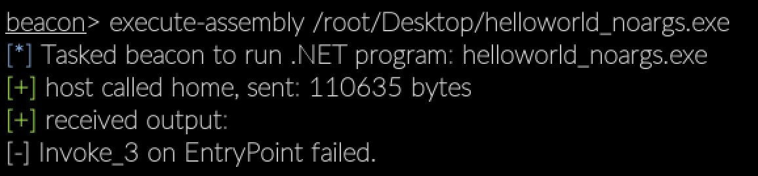
Notes:
Unlike when we ran the C# hello world through execute assembly, this is failing with the error “Invoke_3 on EntryPoint”.

Slide 34
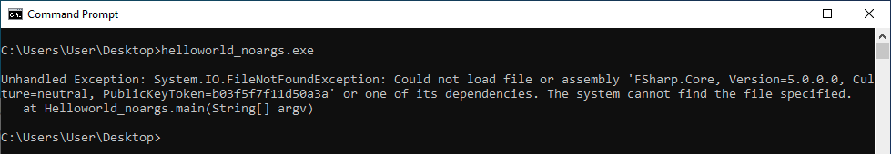
Notes:
JOE DOES THE NEXT 5 SLIDES
We tried running the same basic binary on the victim VM via GUI and this is the error we get. So it’s a slightly different error, but it’s the same root cause. Unlike our C# assembly, the F# assembly relies on Fsharp.Core.dll and that library is not included by default.
Had we caught the error within our F# code, we possibly would have seen this error, however we didn’t so we were presented with the Invoke_3 error
At this point, we were left with trying to figure out our next steps.

Slide 35
Ideas
Stick to C#
Standalone F# Assemblies
Drop FSharp.Core.dll to disk
Add FSharp.Core.dll to Global Assembly Cache (GAC)
Resolve Assembly Dependency Errors

Slide 36
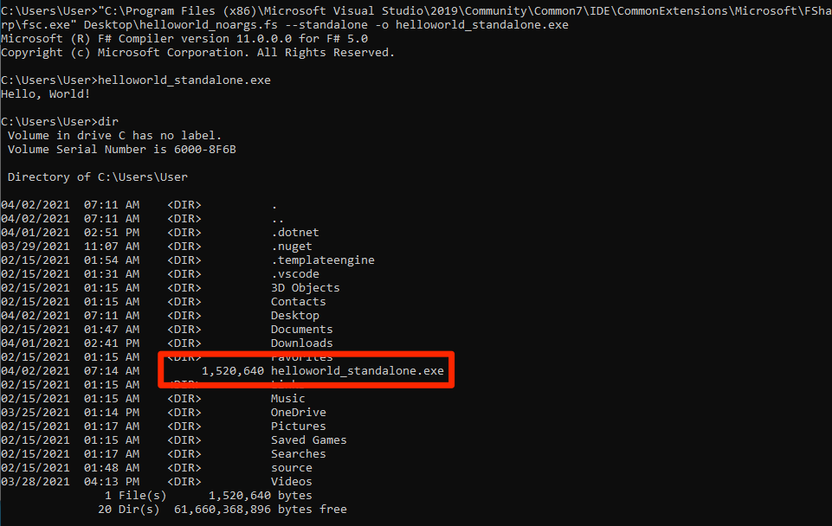
Standalone F# Assemblies
Sorta Works
How:
FSC, the F# compiler, has a standalone flag that embeds all the required resources
Pro:
Self-contained
Local admin not required
Cons:
Huge File
Won’t work with Cobalt Strike
Notes:
Here you can see we’re in a directory without any of the required DLLs, and we simply call the the FSC compiler with the standalone option and then we can execute the assembly.
BUT, it’s massive. 1.5Mb for just printing hello world. If you’re familiar with Cobalt Strike, you’ll know that it does not play nicely with .NET assemblies greater than 1Mb. As a result, while this *could* be a solution, it wasn’t good enough for us.

Slide 37
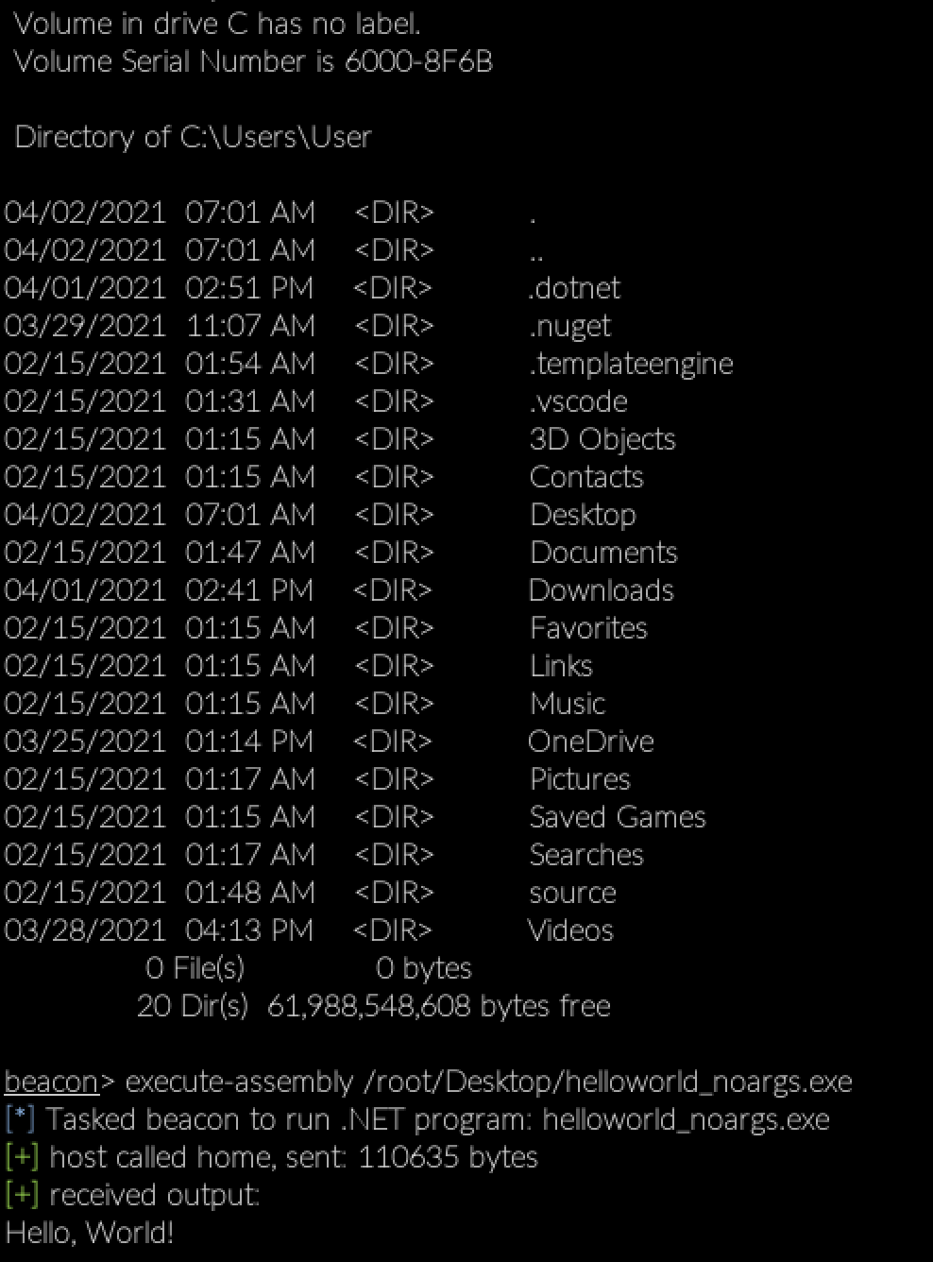
Drop FSharp.Core.dll to Disk
Works!
How:
Drop FSharp.Core.dll into the directory where the spawnto process lives.
Pros:
Scalable for other dependencies.
Cons:
Requires dropping to disk to execute “in-memory”
Almost always requires local admin rights
Notes:
We dropped Fsharp.Core.dll into the directory where our spawnto process lives. If you remember our walkthrough of execute-assembly, the way that technique works, it spawns a process, injects the CLR and then loads your .NET assembly byte array. When we drop our FSharp.Core.dll into the C:\Windows\System32\ directory, the assembly runs smoothly. That’s because we’re injecting into a process that lives in C:\Windows\System32. Of course, you need admin rights to do this. If we were injecting into a process with a user-writable folder, then we wouldn’t need admin rights.
Also, we printed out the current directory before executing the F# assembly to demonstrate that the FSharp dll does not go into the current directory as printed by Cobalt Strike. In fact, it wont’ work. This is likely a byproduct of the spawnto process.

Slide 38
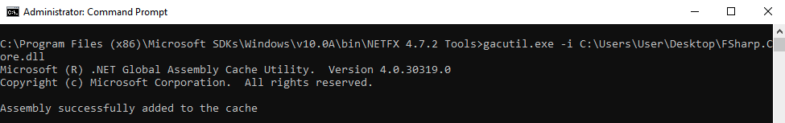
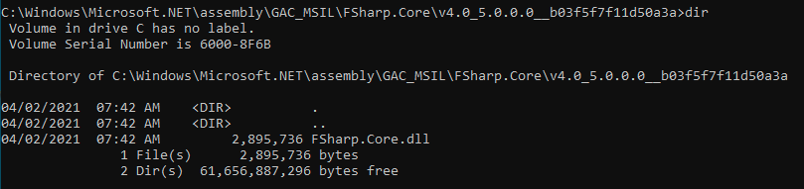
Add FSharp.Core.dll to GAC
Works!
How:
Uses the gacutil program to install the dll into the Global Assembly Cache
Pros:
Install it once, run F# assemblies from anywhere on the host
Cons:
Requires local admin
If Visual Studio not installed, need to temporarily copy over 3 files to get gacutil to work.*
Requires temporarily* dropping FSharp.Core.dll to disk
Notes:
We have temporarily asterisked here b/c while you temporarily drop it to disk to install it, installing it creates a copy of the dll in the GAC, hence the “C” cache.
Honestly, this is a pretty good route to go. Can just run the existing execute-assembly after setting it up with gacutil, but requires local admin.
What is the global assembly cache?
Stores copies of DLLs that are needed system wide.
“Each computer where the Common Language Runtime is installed has a machine-wide code cache called the Global Assembly Cache. The Global Assembly Cache stores assemblies specifically designated to be shared by several applications on the computer.”
*If don’t have Visual Studio installed, you should b able to use this, but we need to verify:
http://seesharpdeveloper.blogspot.com/2015/07/using-gacutil-on-non-development-server.html

Slide 39
Resolve Assembly Dependency Errors
Our ultimate goal was to build a way to run an F# assembly via the execute-assembly technique without needing local admin and without having to drop anything to disk.
After hours of experimenting, we finally came across this post by Jean Maes, which gave us the answer.
AppDomain.AssemblyResolve
Notes:
CHRIS DOES THE NEXT 6 SLIDES
Let’s revisit our execute-assembly codebase and see how we can update it to resolve F# dependency issues.

Slide 40
Load it Up
Let’s take a step back – what question are we trying to answer?
How can we execute F# (managed) code within unmanaged code?
We started investigating possible answers and found a code base to start with
HostingCLR - https://github.com/etormadiv/HostingCLR

Slide 41
Load it Up
HostingCLR is a C++ project that is used to run C#/.NET assemblies from within itself
We wanted to know if this project could natively take an F# assembly and run it
Since we knew how to compile F# assembles, we made a simple hello world in F# as a POC and compiled it with fsc.exe and made a standalone binary
We then took the Hello World application and converted it into a byte array which was embedded within the HostingCLR application
And then we crossed our fingers and ran it….

Slide 42
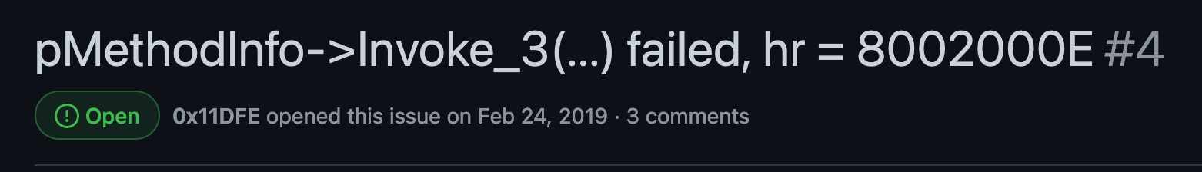
Load it Up
This resulted in multiple errors, some of which we could easily resolve (updating size definitions of constants, etc.)
We still were running into an Invoke_3 error along with a Windows error code
But we got lucky with this…

Slide 43
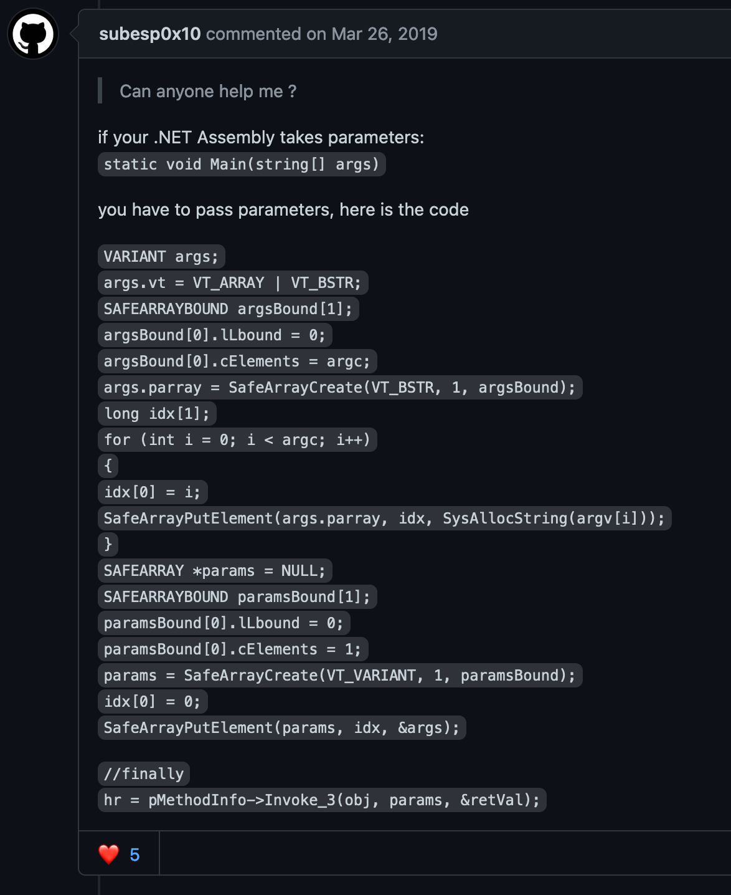

Slide 44
Load it Up
Come to find out, another individual had exactly the same error as us
Not only that, but there was a response from the original developer with code that fixes the issue
How often does this happen?
Now, we could use our existing F# application which accepts arguments and run it within the modified HostingCLR codebase
…But… something was still missing

Slide 45
Notes:
JOE DOES THE NEXT 13 SLIDES

Slide 46
Load it Up
We’re still getting FSharp.Core.dll errors with our code
But that makes sense right?
It’s not in the system’s path
We don’t have it in the same directory
It’s not in the GAC
So what options do we have at this point?
Why not try what we’re currently doing and embed the FSharp.Core.dll within the current project?
This is where AppDomain.AssemblyResolve comes into play

Slide 47
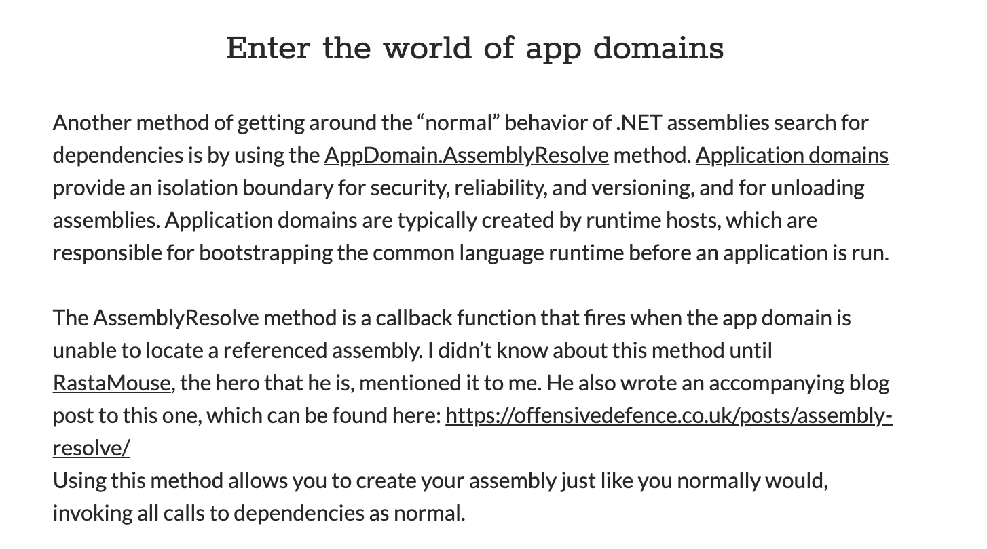

Slide 48
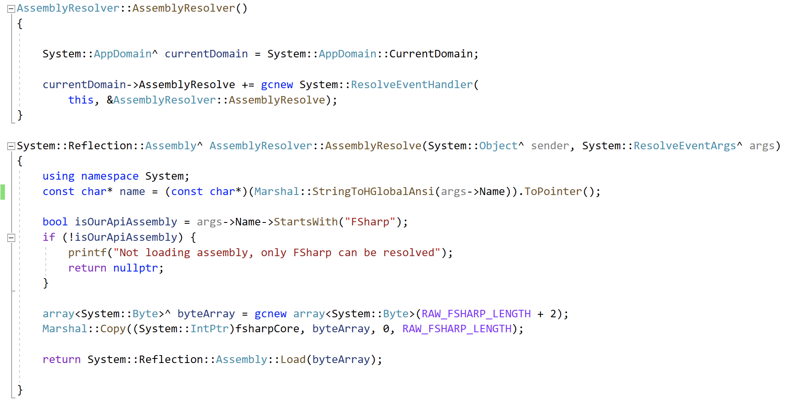
Notes:
Add this in to start right after starting the runtime host

Slide 49
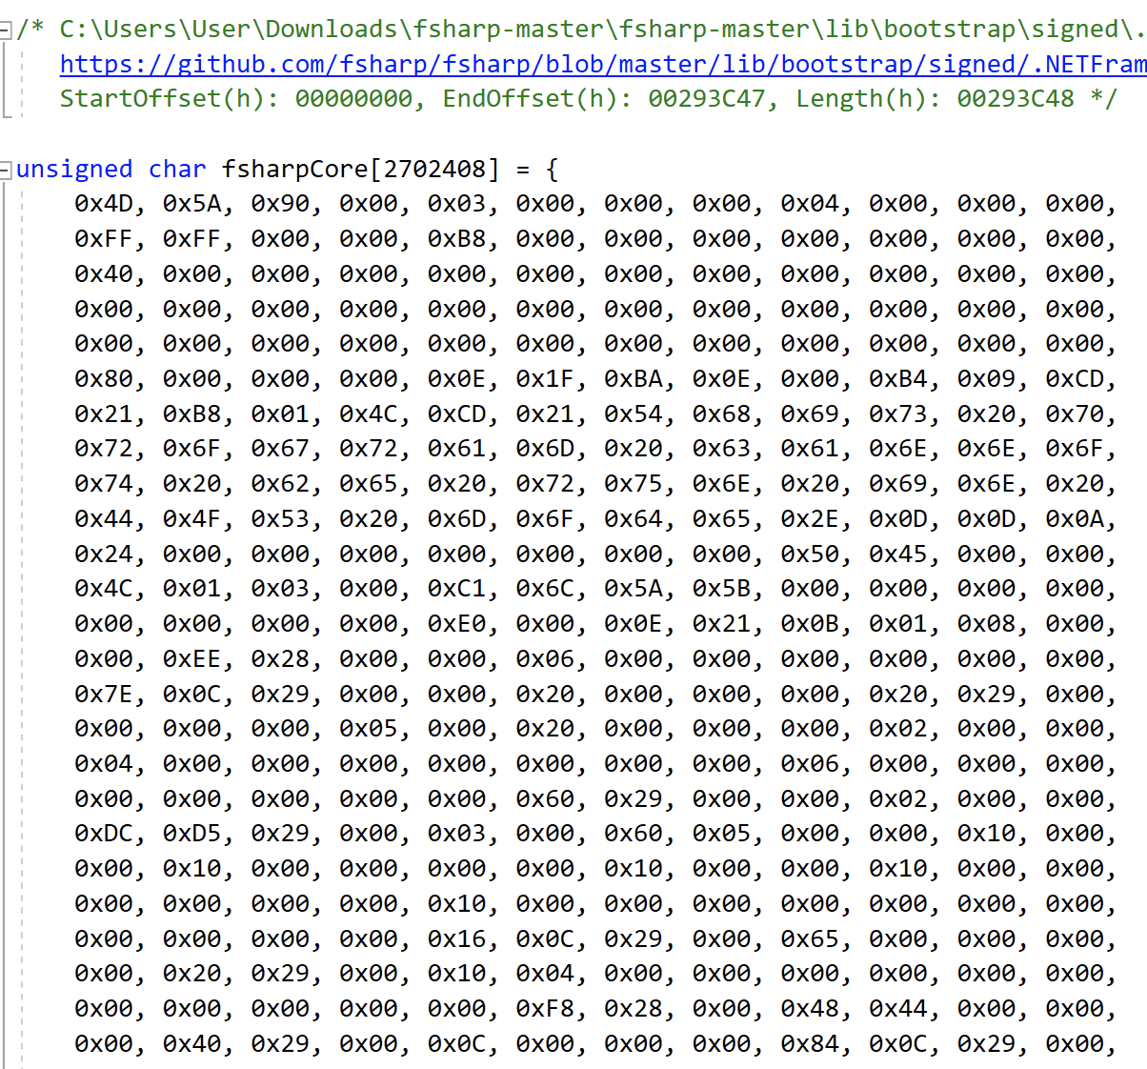
Load it Up
Leveraging AppDomain.AssemblyResolve allowed us to embed a dll (such as FSharp.Core.dll)
Time to add the code and DLL

Slide 50
Load it Up
Lo and behold, by embedding the FSharp.Core.dll within the application, we can execute our F# code

Slide 51
Process Injection in F#

Slide 52
Shellcode in F#
F# requires a unique format for its byte arrays.
It’s not like 0xff or \xff.
Byte format:
0x <your byte in hex> uy;
0xffuy; or 0x3euy;
Byte array format:
byte[] = [|0xffuy;0x9duy;0xa3uy;|]

Slide 53
P/Invoke
In C#, it looks like this:

Slide 54
P/Invoke
In F#, it looks like this:

Slide 55
@vysecurity’s Shellcode Injection PoC

Slide 56
CreateRemoteThread Shellcode Injection

Slide 57
CreateRemoteThread Shellcode Injection

Slide 58
CreateRemoteThread Shellcode Injection

Slide 59
Introducing “WhatTheF”
A collection of resources to conduct offensive assessments using F#.

Slide 60
Shellcode Injection Templates
P/Invoke
Basic Shellcode Injection (@vysecurity’s template)
VirtualAlloc -> Marshal.Copy -> CreateThread -> WaitForSingleObject
Remote Shellcode Injection (CreateRemoteThread)
CreateProcess -> VirtualAllocEx -> WriteProcessMemory -> VirtualProtectEx -> CreateRemoteThread
Remote Shellcode Injection (QueueUserAPC)
CreateProcess -> VirtualAllocEx -> WriteProcessMemory -> VirtualProtectEx -> OpenThread -> QueueUserAPC -> ResumeThread

Slide 61
Bypassing AMSI and ETW with F#
Bypassing AMSI is a relatively trivial task considering multiple websites, tools, and blog posts document how to do so
https://amsi.fail/
https://github.com/S3cur3Th1sSh1t/Amsi-Bypass-Powershell
Rasta Mouse’s Amsi Patch
…etc.
You can utilize these, and other techniques to bypass both AMSI and ETW within F#
We recommend diving into this topic and adding bypasses into your scripts

Slide 62
Guide to Executing F# on Target Hosts
FSI Scripting on Target
Standalone F# Assemblies
Dropping FSharp.Core.dll to disk
Adding FSharp.Core.dll to Global Assembly Cache (GAC)
Resolving Assembly Dependency Errors (aka Execute Assembly)

Slide 63
Roadmap / What’s Next?
Cobalt Strike BOF to execute F# tradecraft in memory (aka avoiding those 1MB+ self-contained F# assmeblies)
SysCalls in F#
Porting some of our C# tooling into F#
Notes:
CHRIS FINISHES THE REST OF THE TALK

Slide 64
Limitations of F#
Notes:
Talk about FSI limitations of dropping to disk.

Slide 65
Limitations
We like coding in Visual Studio when coding with .NET, but compilation in F# with Visual Studio isn’t pretty
While you can use Intellisense with Visual Studio, you can’t compile it
There’s really no ability to create a standalone executable option – even though supposedly StackOverflow says you can
You’re stuck with an executable that loads a DLL and gets your code running
The coding process is likely going to be multi-step, unless you just don’t need/want Visual Studio
You are going to have “large” binaries when everything is self contained
> 1.5 Megabytes

Slide 66
Detecting F# Tradecraft

Slide 67


F# Detection
We’d like to thank Matt Graeber (@mattifestation) and Red Canary @redcanary for reviewing this code
We contacted both and they were more than happy to review and provide detection recommendations for this presentation

Slide 68
F# Detection
AMSI is able to catch and review the full contents of the embedded F# application
.NET ETW can capture loading the embedded F# executable and FSharp.Core.dll
You can easily observe clr.dll and mscoree.dll being loaded
Detection focus should remain on the behaviors related to .NET execution rather than .NET language implementations
.NET and AMSI optics provide rich opportunities to detect the in-memory loading
Review this for attempts to avoid ETW detection - https://www.mdsec.co.uk/2020/03/hiding-your-net-etw/

Slide 69
Key Takeaways
Use F# as an alternative to C# in offensive tooling.
F# can be executed the same as C# in unmanaged code
F# can, and should, be used as a a language for coding tools in from an offensive perspective
Defenders should instrument their fleet to obtain as much telemetry as possible for detection purposes
Spend the time on understanding the behaviors of offensive tooling rather than .NET language implementations

